Slide 1


NEXT HIKES IT SOLUTIONS
Building a basic GUI calculator
BY: AVANTIKA VERMA

Slide 2
AGENDA
INTRODUCTION
KEY FEATURES
CODE BREAKDOWN
CONCLUSION

Slide 3
INTRODUCTION
Tools & Technologies
Programming language- Python
Library- Tkinter
Why Tkinter?
Tkinter is Python's standard GUI (Graphical User Interface) library.
It provides tools to create windows, buttons, and various UI elements.
It is easy to use for building simple applications.

Slide 4
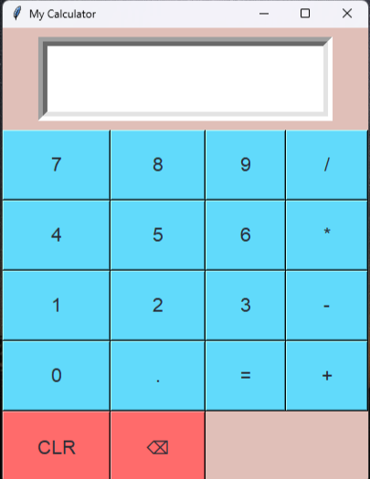
KEY FEATURES
Interactive graphical user interface (GUI) built with Tkinter.
Performs basic arithmetic operations such as Addition, Subtraction, Multiplication and Division (+, -, *, /).
Display screen is used to display the input and evaluated output
It handles input errors (e.g., division by zero). An “ERROR” message pops up when there are any input errors.
It can reset the input using the "CLR" button.
It also has Backspace feature to remove the immediate input errors.

Slide 5
CODE BREAKDOWN
Main Functions:
button_click(value): Updates the expression when a button is pressed.
calculate(): Evaluates the mathematical expression and shows the result.
clear(): Clears the current expression.
GUI Components:
Entry Widget: This is where the user will input the expression and view the result.
Buttons: There are buttons for numbers (0-9), operators (+, -, *, /), the equal sign (=) for evaluation, and a clear button (CLR) to reset the input.

Slide 6
CONCLUSION
How to run:
Install Python and tkinter (it usually comes pre-installed with Python).
Copy the code into a .py file and run it.
This code will open a simple calculator GUI where you can enter numbers, perform basic arithmetic operations, and clear the screen.
GITHUB Repository:
https://github.com/Avantikaverma1402/Building-a-basic-calculator.git

Slide 7
THANK YOU

